Slide 1
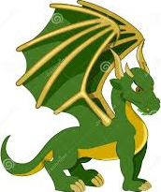
Dragon Slayer 2
By: Janine Baranski

Slide 2
Background
The kingdom of Lali has lived peacefully for years. One day a dark shape covered the sky. The villagers of Lali looked up when the shape let out a loud roar. It was a dragon!
Dragons are known for their greed and violence so the King and Queen summoned their bravest knights together. They led a valiant attack against the dragon but were unsuccessful. As a squire you were not part of the first attack, however, now that there seems to be no one left you want to help.
You decide to go into town to see if there is anyone there who can help. There are characters in town that have items you need. You can either pay for them or choose the correct favor as trade. The favors will trigger puzzles you need to solve.

Slide 3
Characters
Three interactions:
Ask if they need help:
Farmer: Trade him oak for a cow.
Wizard: Trade him herbs for a sleep potion.
Blacksmith: Trade him ore for a dragon scale piercing sword. Buy a shield.
Carpenter: Trade him a love potion for money.
Seamstress: Trade her eggs for money.
Ask to see their shop. Buy or sell items.
Talk to them to gather hints

Slide 4
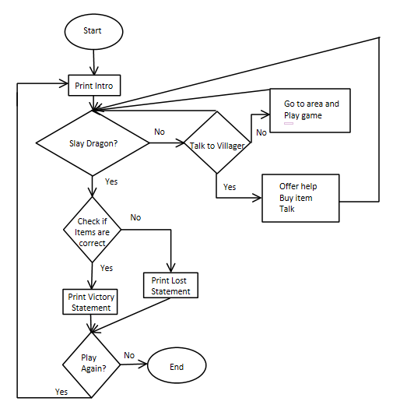
Game Map

Slide 5
Dragon Slayer 2
Mini-sweeper like mini-game now has mouse interactions
New boss battle with dragon

Slide 6


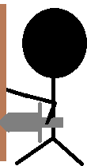


Why should you invest in Dragon Slayer?
New Levels
Hire Graphics Team

